Slide 1
Root Finding Techniques
MAHRUKH KHAN
COMPUTER SCIENCE AND ELECTRICAL ENGINEERING
UNIVERSITY OF MISSOURI ,KANSAS CITY

Slide 2
Root Finding Topics
Bi-section Method
Newton’s method
Uses of root finding for sqrt() and reciprocal sqrt()
Secant Method
Generalized Newton’s method for systems of non-linear equations
  The Jacobian matrix
Fixed-point formulas, Basins of Attraction and Fractals.

Slide 3
Motivation
Many problems can be re-written into a form such as:
  f(x,y,z,…) = 0
  f(x,y,z,…) = g(s,q,…)

Slide 4
Motivation
A root, r, of function f occurs when f(r) = 0.
For example:
  f(x) = x² – 2x – 3
  has two roots at r = -1 and r = 3.
    f(-1) = 1 + 2 – 3 = 0
    f(3) = 9 – 6 – 3 = 0
  We can also look at f in its factored form.
    f(x) = x² – 2x – 3 = (x + 1)(x – 3)

Slide 5
Factored Form of Functions
The factored form is not limited to polynomials.
Consider:
    f(x)= x sin x – sin x.
  A root exists at x = 1.
    f(x) = (x – 1) sin x
Or,
    f(x) = sin πx => x (x – 1) (x – 2) …

Slide 6

Examples
Find x, such that
  x^{p} = c,⇒ x^{p} – c = 0
    Calculate the sqrt(2)
      x² – 2 = 0
Ballistics
  Determine the horizontal distance at which the projectile will intersect the terrain function.

Slide 7
Root Finding Algorithms
Closed or Bracketed techniques
  Bi-section
  Regula-Falsi
Open techniques
  Newton fixed-point iteration
  Secant method
Multidimensional non-linear problems
  The Jacobian matrix
Fixed-point iterations
  Convergence and Fractal Basins of Attraction

Slide 8
Bisection Method
Based on the fact that the function will change signs as it passes thru the root.
    f(a)*f(b) < 0
Once we have a root bracketed, we simply evaluate the mid-point and halve the interval.

Slide 9
Bisection Method
c=(a+b)/2
f(a)>0
f(c)>0
a
c
b
f(b)<0

Slide 10
Bisection Method
Guaranteed to converge to a root if one exists within the bracket.
a = c
f(a)>0
a
c
b
f(c)<0
f(b)<0

Slide 11
Bisection Method
Slowly converges to a root
b = c
f(b)<0
a
c
b

Slide 12
Bisection Method
Simple algorithm:
  Given: a and b, such that f(a)*f(b)<0
  Given: error tolerance, err
  c=(a+b)/2.0; // Find the midpoint
  While( |f(c)| > err ) {
    if( f(a)*f(c) < 0 ) // root in the left half
    b = c;
    else // root in the right half
    a = c;
    c=(a+b)/2.0; // Find the new midpoint
  }
  return c;

Slide 13
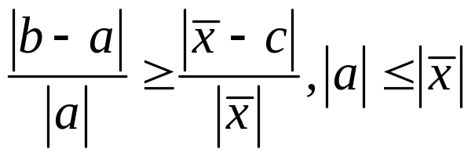
Relative Error
We can develop an upper bound on the relative error quite easily.
a
c
x
b

Slide 14
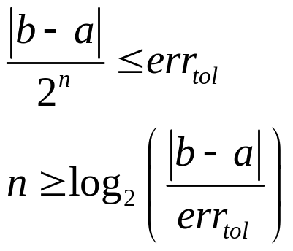
Absolute Error
What does this mean in binary mode?
  err₀ ≤ |b-a|
  err_{i+1} ≤ err_{i}/2 = |b-a|/2^{i+1}
We gain an extra bit each iteration!!!
To reach a desired absolute error tolerance:
  err_{i+1} ≤ err_{tol} ⇒

Slide 15
Absolute Error
The bisection method converges linearly or first-order to the root.
If we need an accuracy of 0.0001 and our initial interval (b-a)=1, then:
      2^{-n} < 0.0001 ⁼⇒ 14 iterations
Not bad, why do I need anything else?

Slide 16
A Note on Functions
Functions can be simple, but I may need to evaluate it many many times.
Or, a function can be extremely complicated. Consider:
    Interested in the configuration of air vents (position, orientation, direction of flow) that makes the temperature in the room at a particular position (teacher’s desk) equal to 72°.
    Is this a function?

Slide 17
A Note on Functions
This function may require a complex three-dimensional heat-transfer coupled with a fluid-flow simulation to evaluate the function. ⇒ hours of computational time on a supercomputer!!!
May not necessarily even be computational.
Techniques existed before the Babylonians.

Slide 18
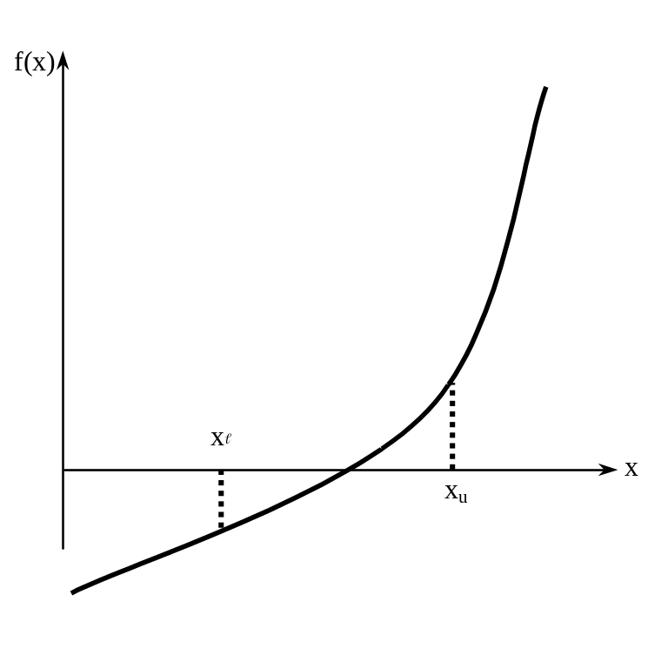
Basis of Bisection Method
An equation f(x)=0, where f(x) is a real continuous function, has at least one root between x_{l} and x_{u} if f(x_{l}) f(x_{u}) < 0.
Figure 1 At least one root exists between the two points if the function is real, continuous, and changes sign.

Slide 19
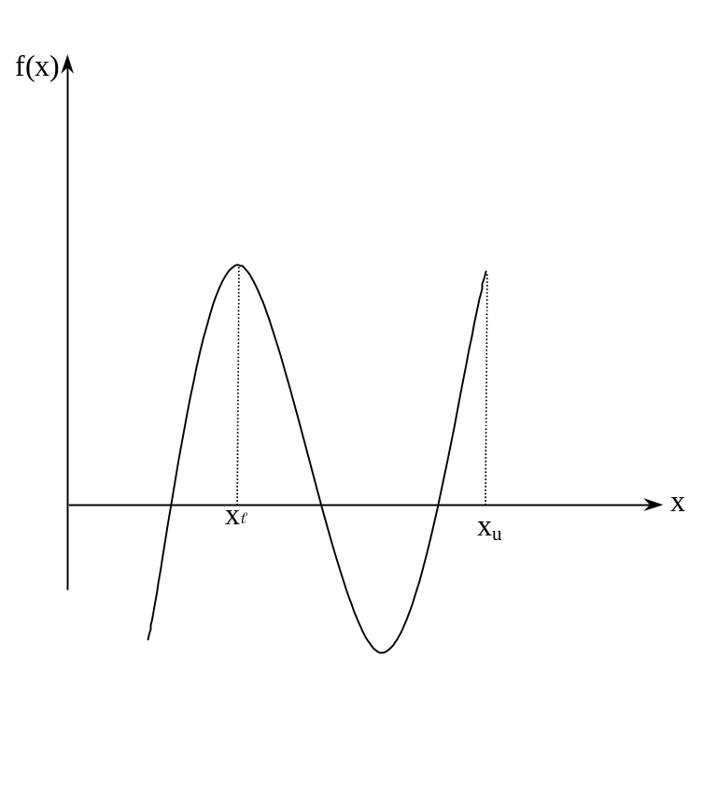


Basis of Bisection Method
Figure 2 If function does not change sign between two points, roots of the equation may still exist between the two points.

Slide 20
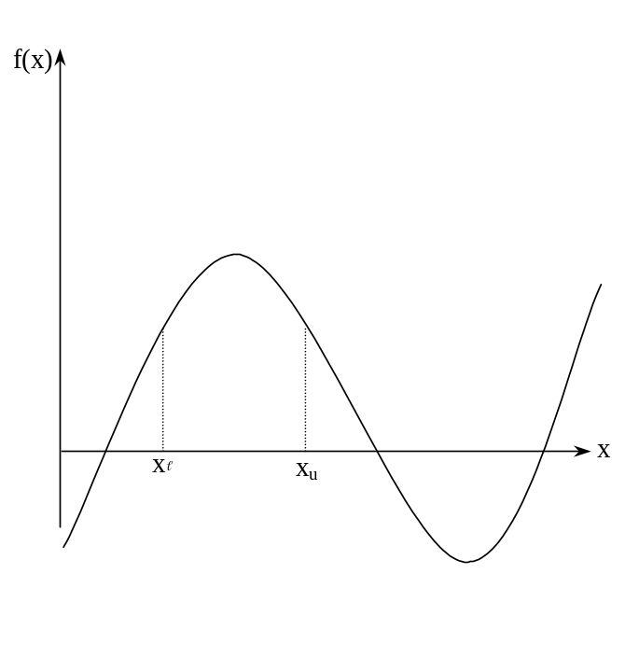
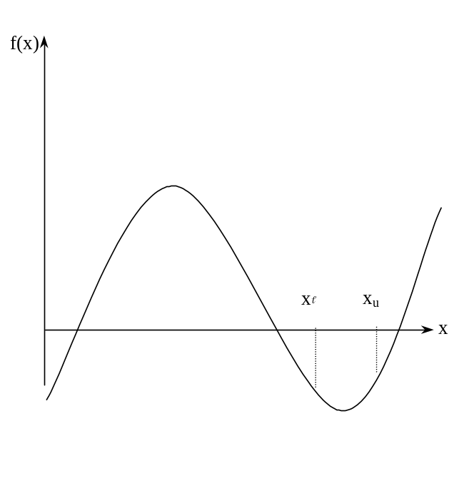
Basis of Bisection Method
Figure 3 If the function does not change sign between two points, there may not be any roots for the equation between the two points.

Slide 21
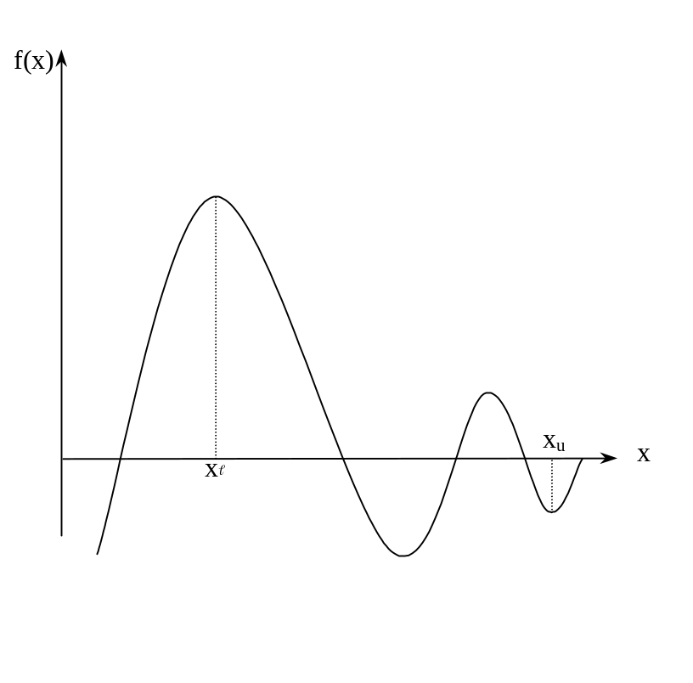
Basis of Bisection Method
Figure 4 If the function changes sign between two points, more than one root for the equation may exist between the two points.

Slide 22
Algorithm for Bisection Method

Slide 23
Step 1
Choose x and x_{u} as two guesses for the root such that f(x) f(x_{u}) < 0, or in other words, f(x) changes sign between x and x_{u}. This was demonstrated in Figure 1.

Slide 24
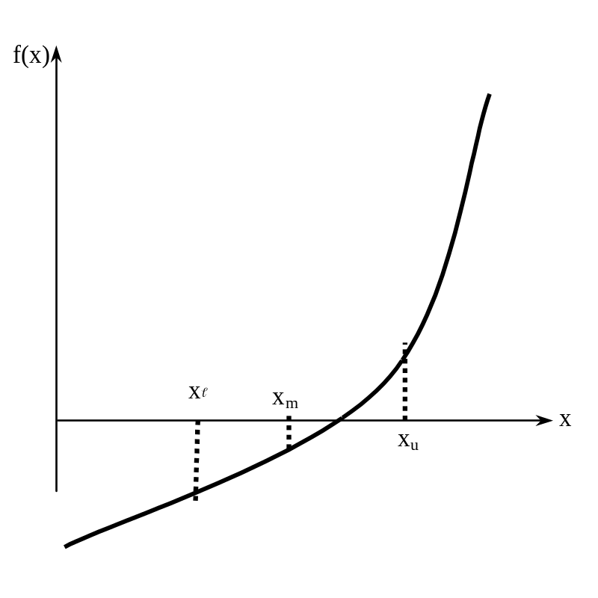
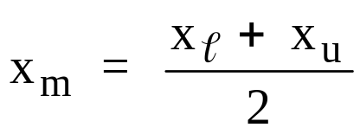
Step 2
Estimate the root, x_{m} of the equation f (x) = 0 as the mid point between x and x_{u} as

Slide 25



Now check the following
If , then the root lies between x and x_{m}; then x = x ; x_{u} = x_{m}.
If , then the root lies between x_{m} and x_{u}; then x = x_{m}; x_{u} = x_{u}.
If ; then the root is x_{m.} Stop the algorithm if this is true.

Slide 26
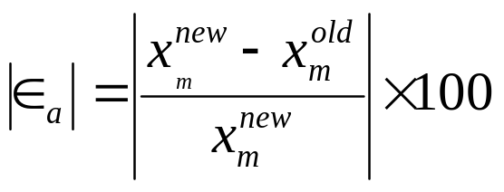


Step 4
Find the new estimate of the root
Find the absolute relative approximate error
where

Slide 27
Step 4
Find the new estimate of the root
Find the absolute relative approximate error
where

Slide 28
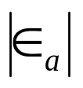


Step 5
Compare the absolute relative approximate error with the pre-specified error tolerance .
Go to Step 2 using new upper and lower guesses.
Yes
Is ?
No
Stop the algorithm
Note one should also check whether the number of iterations is more than the maximum number of iterations allowed. If so, one needs to terminate the algorithm and notify the user about it.

Slide 29

Example 1
You are working for ‘DOWN THE TOILET COMPANY’ that makes floats for ABC commodes. The floating ball has a specific gravity of 0.6 and has a radius of 5.5 cm. You are asked to find the depth to which the ball is submerged when floating in water.
Figure 6 Diagram of the floating ball

Slide 30

Example 1 Cont.
The equation that gives the depth x to which the ball is submerged under water is given by
a) Use the bisection method of finding roots of equations to find the depth x to which the ball is submerged under water. Conduct three iterations to estimate the root of the above equation.
b) Find the absolute relative approximate error at the end of each iteration, and the number of significant digits at least correct at the end of each iteration.

Slide 31
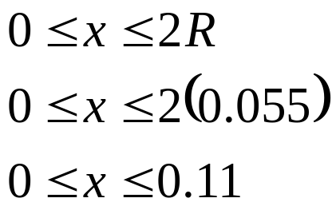
Example 1 Cont.
From the physics of the problem, the ball would be submerged between x = 0 and x = 2R,
where R = radius of the ball,
that is
Figure 6 Diagram of the floating ball

Slide 32
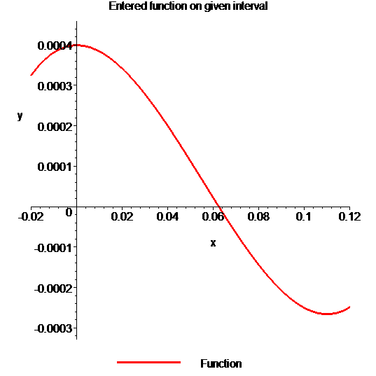
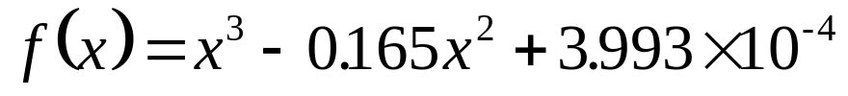
Example 1 Cont.
Solution
To aid in the understanding of how this method works to find the root of an equation, the graph of f(x) is shown to the right,
where
Figure 7 Graph of the function f(x)

Slide 33
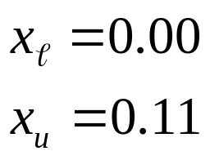
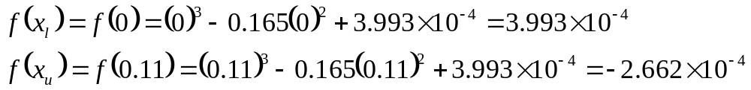
Example 1 Cont.
Let us assume
Check if the function changes sign between x and x_{u .}
Hence
So there is at least on root between x and x_{u,} that is between 0 and 0.11

Slide 34
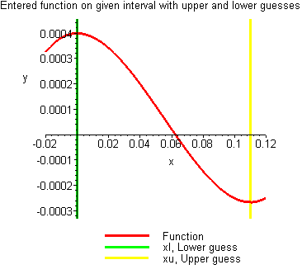
Example 1 Cont.
Figure 8 Graph demonstrating sign change between initial limits

Slide 35
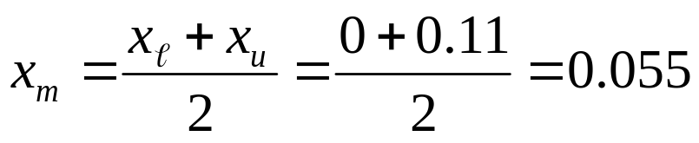
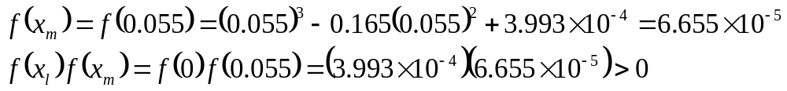


Example 1 Cont.
Iteration 1
The estimate of the root is
Hence the root is bracketed between x_{m} and x_{u}, that is, between 0.055 and 0.11. So, the lower and upper limits of the new bracket are
At this point, the absolute relative approximate error cannot be calculated as we do not have a previous approximation.

Slide 36
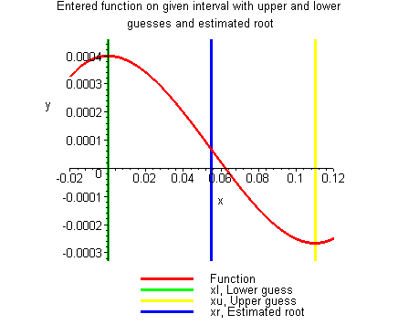
Example 1 Cont.
Figure 9 Estimate of the root for Iteration 1

Slide 37
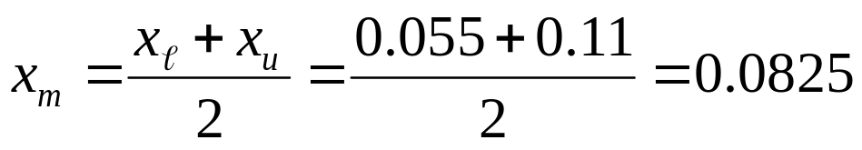
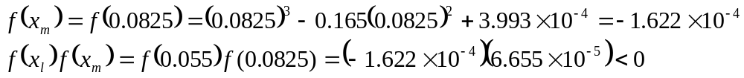

Example 1 Cont.
Iteration 2
The estimate of the root is
Hence the root is bracketed between x and x_{m}, that is, between 0.055 and 0.0825. So, the lower and upper limits of the new bracket are

Slide 38
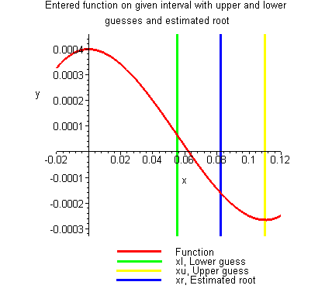
Example 1 Cont.
Figure 10 Estimate of the root for Iteration 2

Slide 39

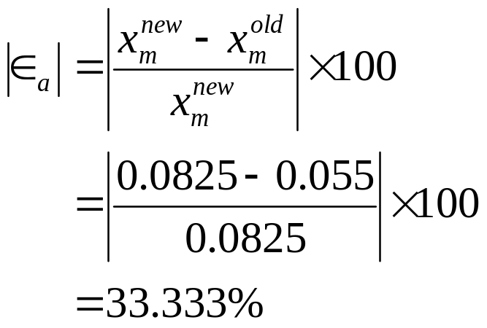
Example 1 Cont.
The absolute relative approximate error at the end of Iteration 2 is
None of the significant digits are at least correct in the estimate root of x_{m} = 0.0825 because the absolute relative approximate error is greater than 5%.

Slide 40
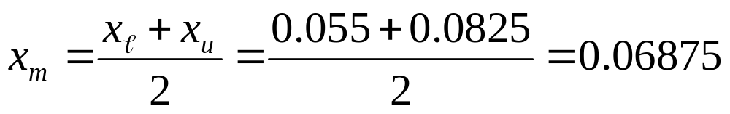
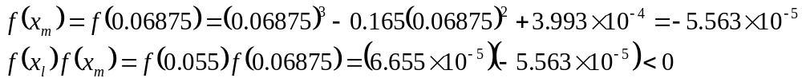

Example 1 Cont.
Iteration 3
The estimate of the root is
Hence the root is bracketed between x and x_{m}, that is, between 0.055 and 0.06875. So, the lower and upper limits of the new bracket are

Slide 41
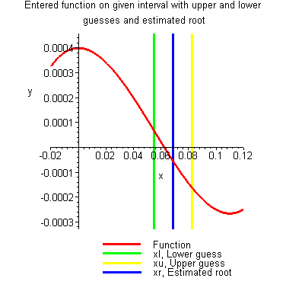
Example 1 Cont.
Figure 11 Estimate of the root for Iteration 3

Slide 42
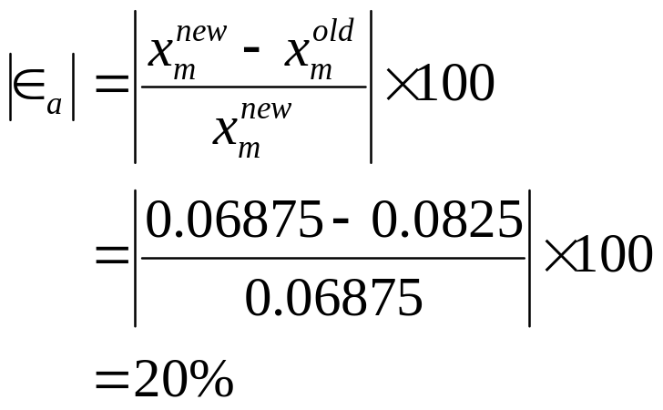
Example 1 Cont.
The absolute relative approximate error at the end of Iteration 3 is
Still none of the significant digits are at least correct in the estimated root of the equation as the absolute relative approximate error is greater than 5%.
Seven more iterations were conducted and these iterations are shown in Table 1.

Slide 43
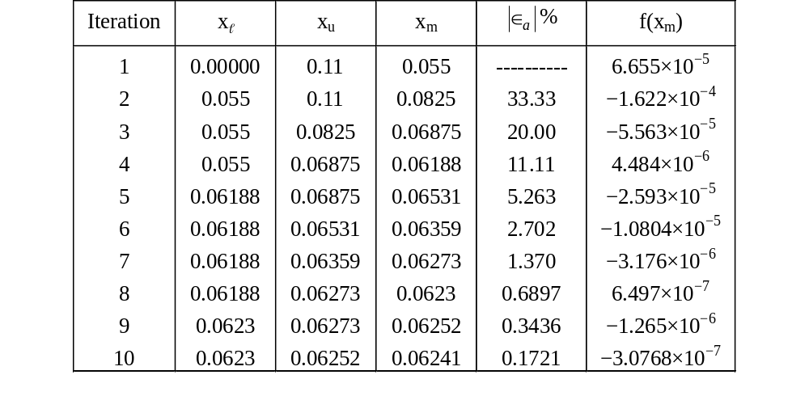
Table 1 Cont.
Table 1 Root of f(x)=0 as function of number of iterations for bisection method.

Slide 44
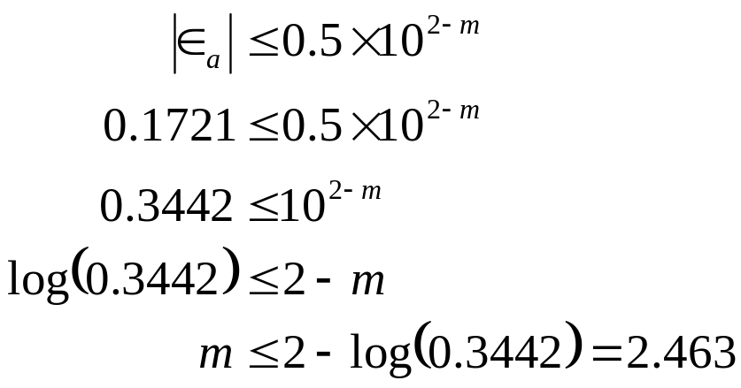

Table 1 Cont.
Hence the number of significant digits at least correct is given by the largest value or m for which
So
The number of significant digits at least correct in the estimated root of 0.06241 at the end of the 10th iteration is 2.

Slide 45
Bracketing Methods
Bracketing methods are robust
Convergence typically slower than open methods
Use to find approximate location of roots
“Polish” with open methods
Relies on identifying two points a,b initially such that:
    f(a) f(b) < 0
Guaranteed to converge

Slide 46
Advantages
Always convergent
The root bracket gets halved with each iteration - guaranteed.

Slide 47
Drawbacks
Slow convergence
If one of the initial guesses is close to the root, the convergence is slower

Slide 48
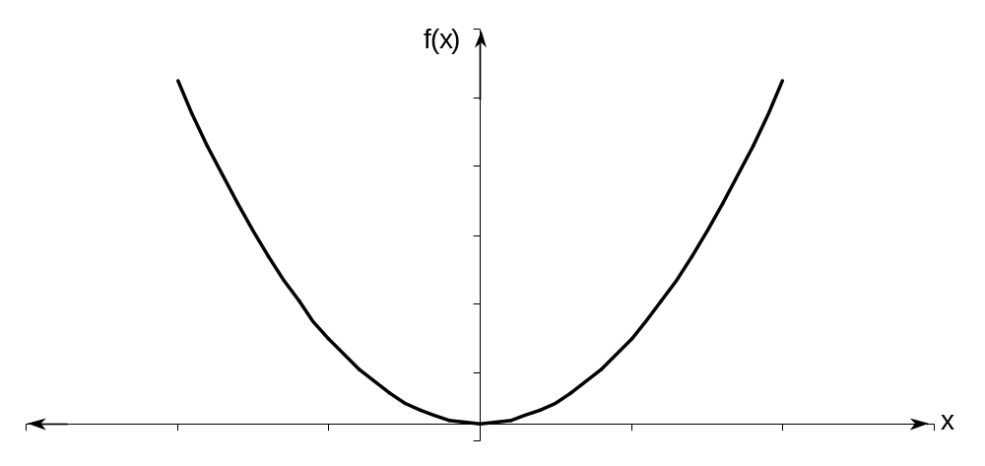
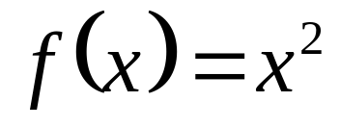
Drawbacks (continued)
If a function f(x) is such that it just touches the x-axis it will be unable to find the lower and upper guesses.

Slide 49
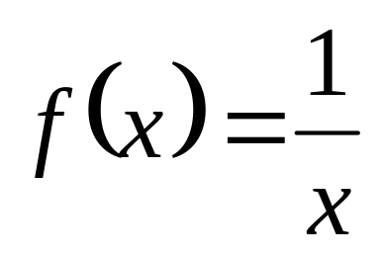
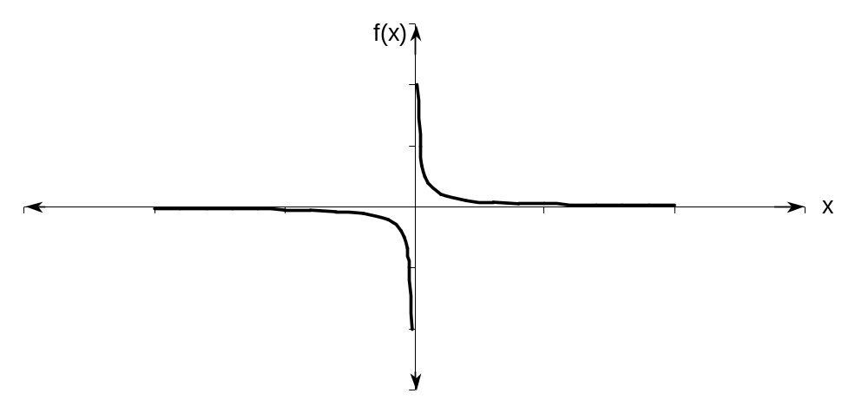
Drawbacks (continued)
Function changes sign but root does not exist

Slide 50
Newton-Raphson Method

Slide 51
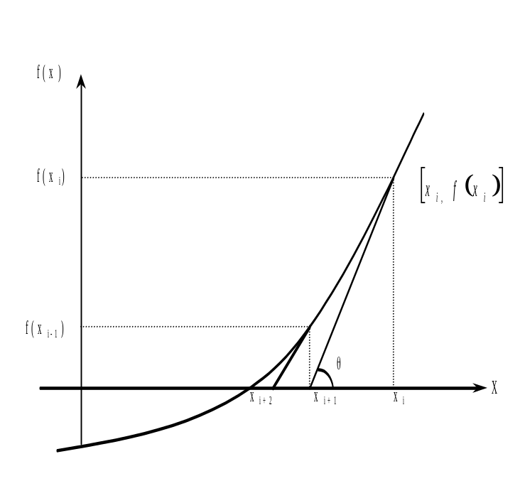
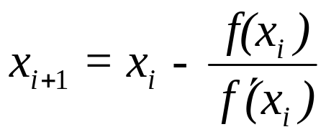
Newton-Raphson Method

Slide 52
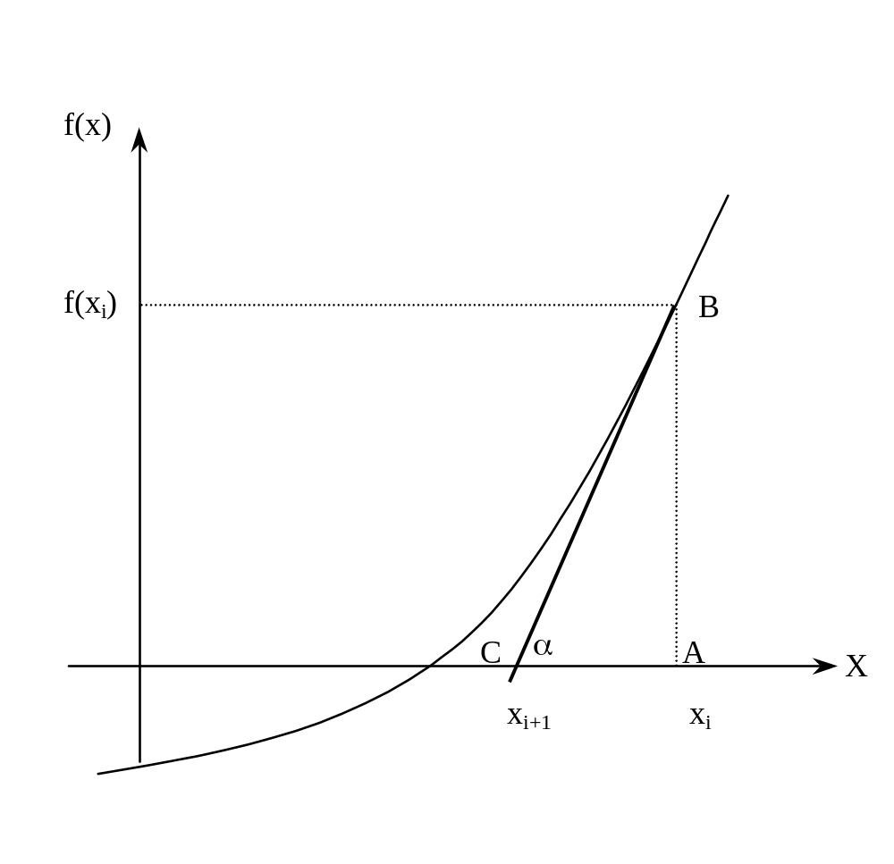
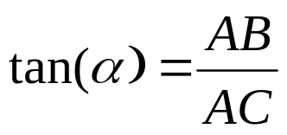
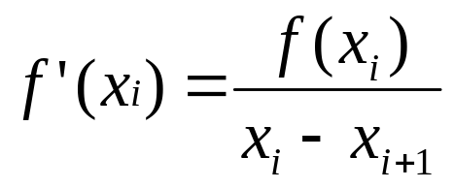
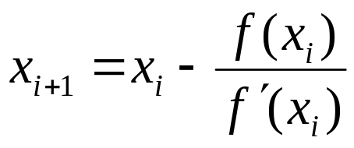
Derivation
Figure 2 Derivation of the Newton-Raphson method.

Slide 53
Algorithm for Newton-Raphson Method

Slide 54

Step 1
Evaluate
symbolically.

Slide 55

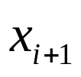
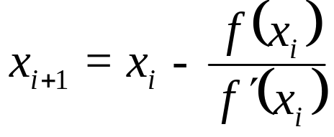
Step 2
Use an initial guess of the root, , to estimate the new value of the root, , as

Slide 56
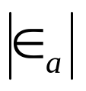
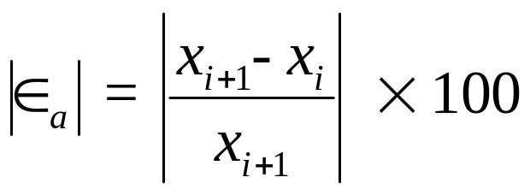
Step 3
Find the absolute relative approximate error as

Slide 57

Step 4
Compare the absolute relative approximate error with the pre-specified relative error tolerance .
Also, check if the number of iterations has exceeded the maximum number of iterations allowed. If so, one needs to terminate the algorithm and notify the user.
Yes
Go to Step 2 using new estimate of the root.
Is ?
No
Stop the algorithm

Slide 58
Example 1
You are working for ‘DOWN THE TOILET COMPANY’ that makes floats for ABC commodes. The floating ball has a specific gravity of 0.6 and has a radius of 5.5 cm. You are asked to find the depth to which the ball is submerged when floating in water.
Figure 3 Floating ball problem.

Slide 59
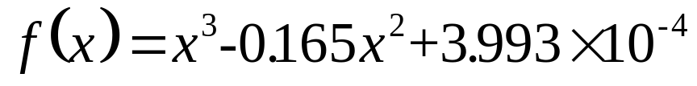

Example 1 Cont.
The equation that gives the depth x in meters to which the ball is submerged under water is given by
Figure 3 Floating ball problem.

Slide 60
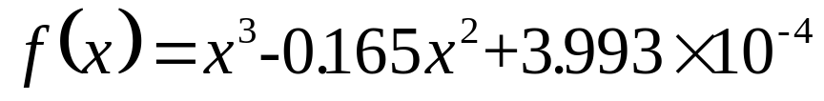
Example 1 Cont.
Solution
To aid in the understanding of how this method works to find the root of an equation, the graph of f(x) is shown to the right,
where
Figure 4 Graph of the function f(x)

Slide 61

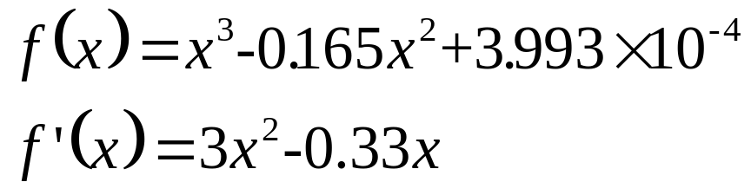
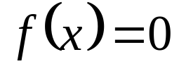
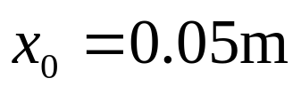


Example 1 Cont.
Solve for
Let us assume the initial guess of the root of is . This is a reasonable guess (discuss why
and are not good choices) as the extreme values of the depth x would be 0 and the diameter (0.11 m) of the ball.

Slide 62
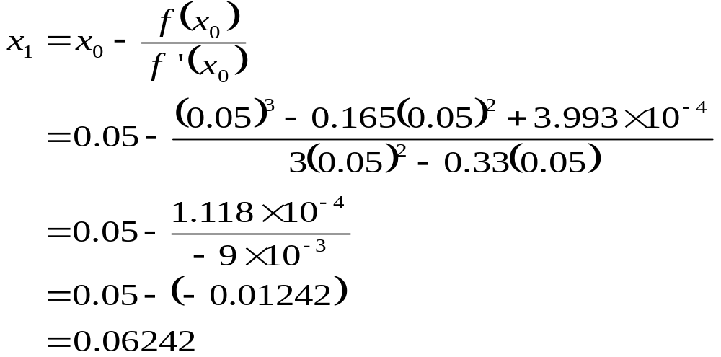
Example 1 Cont.
Iteration 1
The estimate of the root is

Slide 63

Example 1 Cont.
Figure 5 Estimate of the root for the first iteration.

Slide 64


Example 1 Cont.
The absolute relative approximate error at the end of Iteration 1 is
The number of significant digits at least correct is 0, as you need an absolute relative approximate error of 5% or less for at least one significant digits to be correct in your result.

Slide 65

Example 1 Cont.
Iteration 2
The estimate of the root is

Slide 66

Example 1 Cont.
Figure 6 Estimate of the root for the Iteration 2.

Slide 67


Example 1 Cont.
The absolute relative approximate error at the end of Iteration 2 is
The maximum value of m for which is 2.844. Hence, the number of significant digits at least correct in the answer is 2.

Slide 68

Example 1 Cont.
Iteration 3
The estimate of the root is

Slide 69

Example 1 Cont.
Figure 7 Estimate of the root for the Iteration 3.

Slide 70

Example 1 Cont.
The absolute relative approximate error at the end of Iteration 3 is
The number of significant digits at least correct is 4, as only 4 significant digits are carried through all the calculations.

Slide 71
Advantages and Drawbacks of Newton Raphson Method

Slide 72
Advantages
Converges fast (quadratic convergence), if it converges.
Requires only one guess

Slide 73





Drawbacks
Divergence at inflection points
Selection of the initial guess or an iteration value of the root that is close to the inflection point of the function may start diverging away from the root in the Newton-Raphson method.
For example, to find the root of the equation .
The Newton-Raphson method reduces to .
Table 1 shows the iterated values of the root of the equation.
The root starts to diverge at Iteration 6 because the previous estimate of 0.92589
is close to the inflection point of
Eventually after 12 more iterations the root converges to the exact value
of

Slide 74


Drawbacks – Inflection Points
Table 1 Divergence near inflection point.
Iteration Number | x_{i}
0 | 5.0000
1 | 3.6560
2 | 2.7465
3 | 2.1084
4 | 1.6000
5 | 0.92589
6 | −30.119
7 | −19.746
18 | 0.2000
Figure 8 Divergence at inflection point for

Slide 75




Drawbacks – Division by Zero
Division by zero
For the equation
the Newton-Raphson method reduces to
For , the denominator will equal zero.
Figure 9 Pitfall of division by zero or near a zero number

Slide 76

Drawbacks – Oscillations near local maximum and minimum
3. Oscillations near local maximum and minimum
Results obtained from the Newton-Raphson method may oscillate about the local maximum or minimum without converging on a root but converging on the local maximum or minimum.
Eventually, it may lead to division by a number close to zero and may diverge.
For example for the equation has no real roots.

Slide 77





Drawbacks – Oscillations near local maximum and minimum
Table 3 Oscillations near local maxima and mimima in Newton-Raphson method.
Iteration Number
0 1 2 3 4 5 6 7 8 9 | –1.0000 0.5 –1.75 –0.30357 3.1423 1.2529 –0.17166 5.7395 2.6955 0.97678 | 3.00 2.25 5.063 2.092 11.874 3.570 2.029 34.942 9.266 2.954 | 300.00 128.571 476.47 109.66 150.80 829.88 102.99 112.93 175.96
Figure 10 Oscillations around local minima for .

Slide 78






Drawbacks – Root Jumping
4. Root Jumping
In some cases where the function is oscillating and has a number of roots, one may choose an initial guess close to a root. However, the guesses may jump and converge to some other root.
For example
Choose
It will converge to
instead of
Figure 11 Root jumping from intended location of root for
.

Slide 79
Secant Method

Slide 80


Secant Method – Derivation
Newton’s Method
(1)
Approximate the derivative
(2)
Substituting Equation (2) into Equation (1) gives the Secant method
Figure 1 Geometrical illustration of the Newton-Raphson method.

Slide 81



Secant Method – Derivation
The secant method can also be derived from geometry:
The Geometric Similar Triangles
can be written as
On rearranging, the secant method is given as
Figure 2 Geometrical representation of the Secant method.

Slide 82
Algorithm for Secant Method

Slide 83


Step 1
Calculate the next estimate of the root from two initial guesses
Find the absolute relative approximate error

Slide 84
Step 2
Find if the absolute relative approximate error is greater than the pre specified relative error tolerance.
If so, go back to step 1, else stop the algorithm.
Also check if the number of iterations has exceeded the maximum number of iterations.

Slide 85
Example 1
You are working for ‘DOWN THE TOILET COMPANY’ that makes floats for ABC commodes. The floating ball has a specific gravity of 0.6 and has a radius of 5.5 cm. You are asked to find the depth to which the ball is submerged when floating in water.
Figure 3 Floating Ball Problem.

Slide 86

Example 1 Cont
The equation that gives the depth x to which the ball is submerged under water is given by
Use the Secant method of finding roots of equations to find the depth x to which the ball is submerged under water.
Conduct three iterations to estimate the root of the above equation.
Find the absolute relative approximate error and the number of significant digits at least correct at the end of each iteration.

Slide 87

Example 1 Cont.
Solution
To aid in the understanding of how this method works to find the root of an equation, the graph of f(x) is shown to the right,
where
Figure 4 Graph of the function f(x).

Slide 88




Example 1 Cont.
Let us assume the initial guesses of the root of
as and
Iteration 1
The estimate of the root is

Slide 89


Example 1 Cont.
The absolute relative approximate error at the end of Iteration 1 is
The number of significant digits at least correct is 0, as you need an absolute relative approximate error of 5% or less for one significant digits to be correct in your result.

Slide 90

Example 1 Cont.
Figure 5 Graph of results of Iteration 1.

Slide 91

Example 1 Cont.
Iteration 2
The estimate of the root is

Slide 92

Example 1 Cont.
The absolute relative approximate error at the end of Iteration 2 is
The number of significant digits at least correct is 1, as you need an absolute relative approximate error of 5% or less.

Slide 93

Example 1 Cont.
Figure 6 Graph of results of Iteration 2.

Slide 94

Example 1 Cont.
Iteration 3
The estimate of the root is

Slide 95

Example 1 Cont.
The absolute relative approximate error at the end of Iteration 3 is
The number of significant digits at least correct is 5, as you need an absolute relative approximate error of 0.5% or less.

Slide 96

Iteration #3
Figure 7 Graph of results of Iteration 3.

Slide 97
Advantages
Converges fast, if it converges
Requires two guesses that do not need to bracket the root

Slide 98


Drawbacks
Division by zero

Slide 99


Drawbacks (continued)
Root Jumping

Slide 100
THE END

